Slide 1
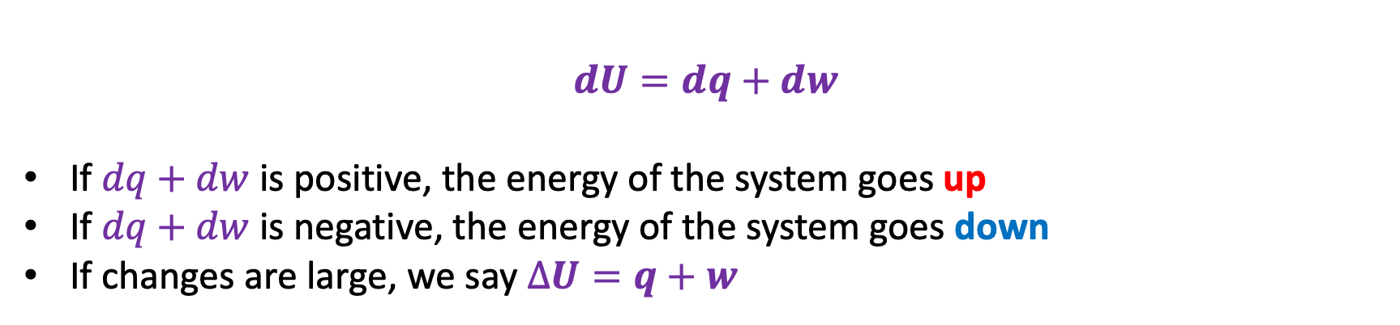
Week 6 – 1st Law
Heat, work, and the 1st Law
Explore how that relates to the behavior of gases as they expand & contract
Constructed Carnot cycles
$$dU=dq+dw$$
If $dq+dw$ is positive, the energy of the system goes up
If $dq+dw$ is negative, the energy of the system goes down
If changes are large, we say $∆U=q+w$

Slide 2
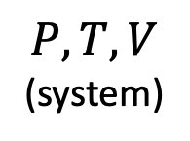
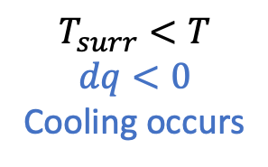
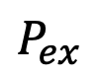
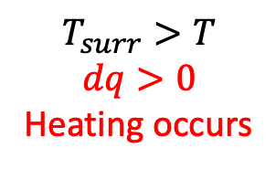
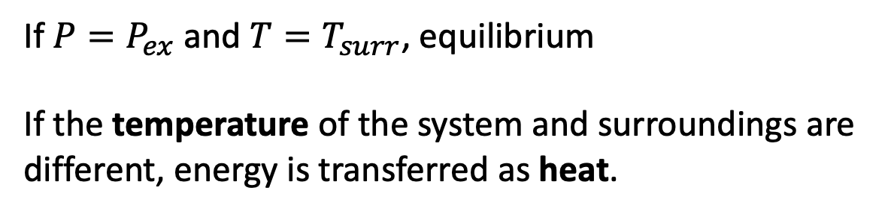
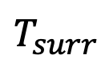
Week 6 – How thermodynamics frames the idea of heat and work
If $P=P_{ex}$ and $T=T_{surr}$, equilibrium
If the temperature of the system and surroundings are different, energy is transferred as heat.
$$P_{ex}$$
$$T_{surr}<T$$
$$dq<0$$
Cooling occurs
$$T_{surr}>T$$
$$dq>0$$
Heating occurs
$$T_{surr}$$
$$P,T,V$$
(system)
surroundings
T
(system)

Slide 3
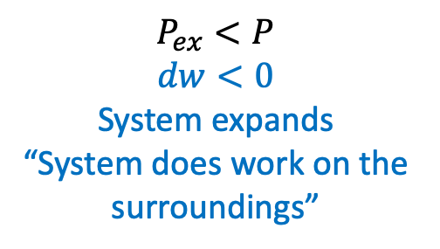
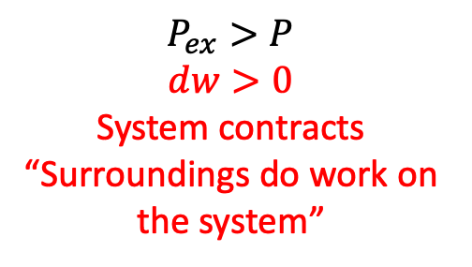
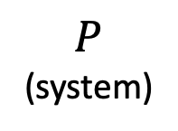
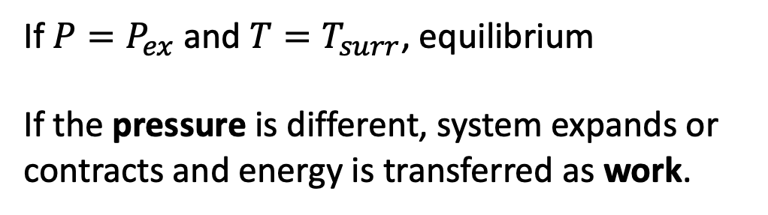
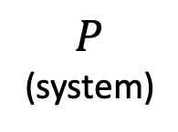
Week 6 – How thermodynamics frames the idea of heat and work
If $P=P_{ex}$ and $T=T_{surr}$, equilibrium
If the pressure is different, system expands or contracts and energy is transferred as work.
$$P_{ex}$$
$$P_{ex}<P$$
$$dw<0$$
System expands
“System does work on the surroundings”
$$P_{ex}>P$$
$$dw>0$$
System contracts
“Surroundings do work on the system”
$$T_{surr}$$
$$P,T,V$$
(system)
surroundings
$$P$$
(system)
$$P$$
(system)

Slide 4
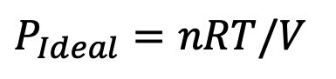
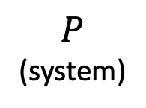
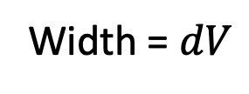
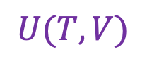
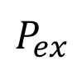
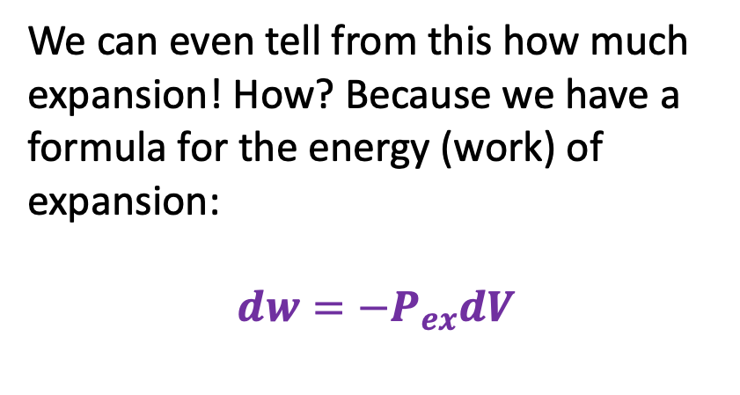
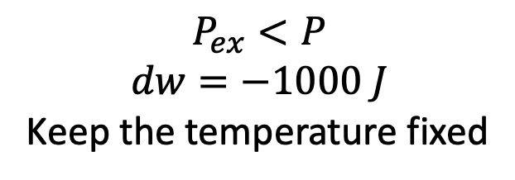
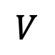
Week 6 – PV work, single step
$$P_{ex}<P$$
$$dw=−1000 J$$
Keep the temperature fixed
$$U(T,V)$$
V
We can even tell from this how much expansion! How? Because we have a formula for the energy (work) of expansion:
$$dw=−P_{ex}dV$$
T
$$P$$
(system)
$$P_{ex}$$
$$P_{Ideal}=nRT/V$$
Width = $dV$
$$V$$

Slide 5
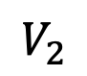
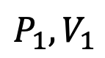
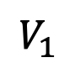
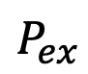
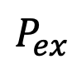

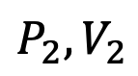
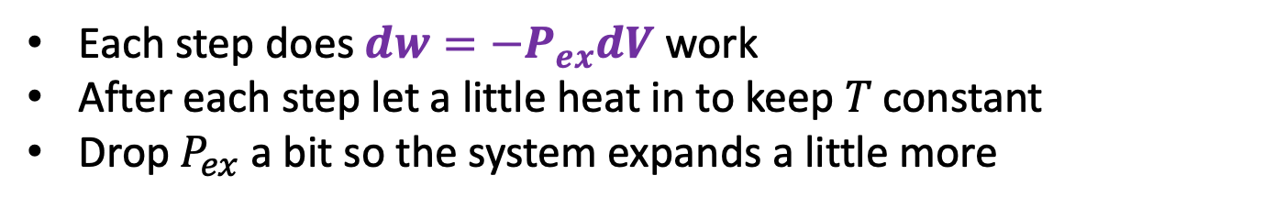
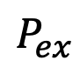
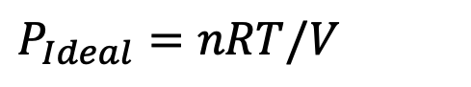
Week 6 – Multistep isothermal expansion/contraction of an ideal gas
Each step does $dw=−P_{ex}dV$ work
After each step let a little heat in to keep $T$constant
Drop $P_{ex}$ a bit so the system expands a little more
$$w=−nRTln(\frac{V_{2}}{V_{1}})$$
$$q=+nRTln(\frac{V_{2}}{V_{1}})$$
$$P_{ex}$$
$$P_{ex}$$
$$P_{2},V_{2}$$
$$P_{1},V_{1}$$
$$P_{ex}$$
$$P_{Ideal}=nRT/V$$
$$V_{1}$$
$$V_{2}$$

Slide 6
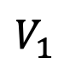
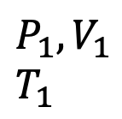
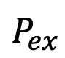
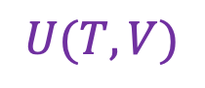
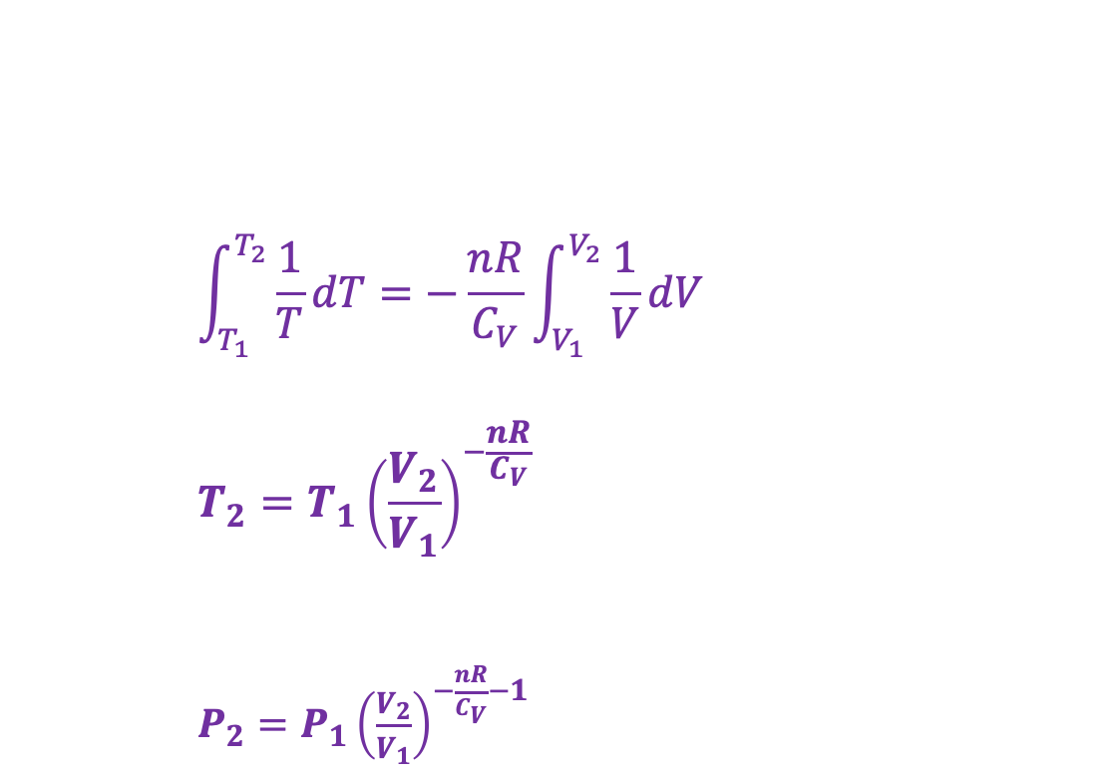
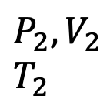
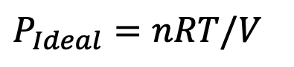
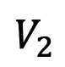
Week 6 – Multistep adiabatic expansion/contraction of an ideal gas
$$\int_{T_{1}}^{T_{2}}{\frac{1}{T}dT}=−\frac{nR}{C_{V}}\int_{V_{1}}^{V_{2}}{\frac{1}{V}dV}$$
$$T_{2}=T_{1}{\left(\frac{V_{2}}{V_{1}}\right)}^{−\frac{nR}{C_{V}}}$$
$P_{2}={P_{1}\left(\frac{V_{2}}{V_{1}}\right)}^{−\frac{nR}{C_{V}}−1}$
$$U(T,V)$$
V
$$P_{ex}$$
T
$$P_{ex}$$
$$P_{2},V_{2}$$
$$T_{2}$$
$$P_{1},V_{1}$$
$$T_{1}$$
$$P_{ex}$$
No heat going in/out
Temperature is going down
$$P_{Ideal}=nRT/V$$
$$V_{1}$$
$$V_{2}$$

Slide 7
Week 6 – Thermal power generators (in Thermo, “heat engines”)

Slide 8
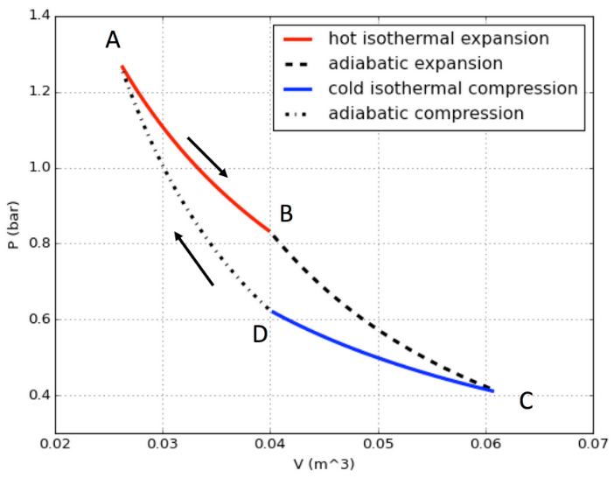
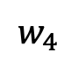
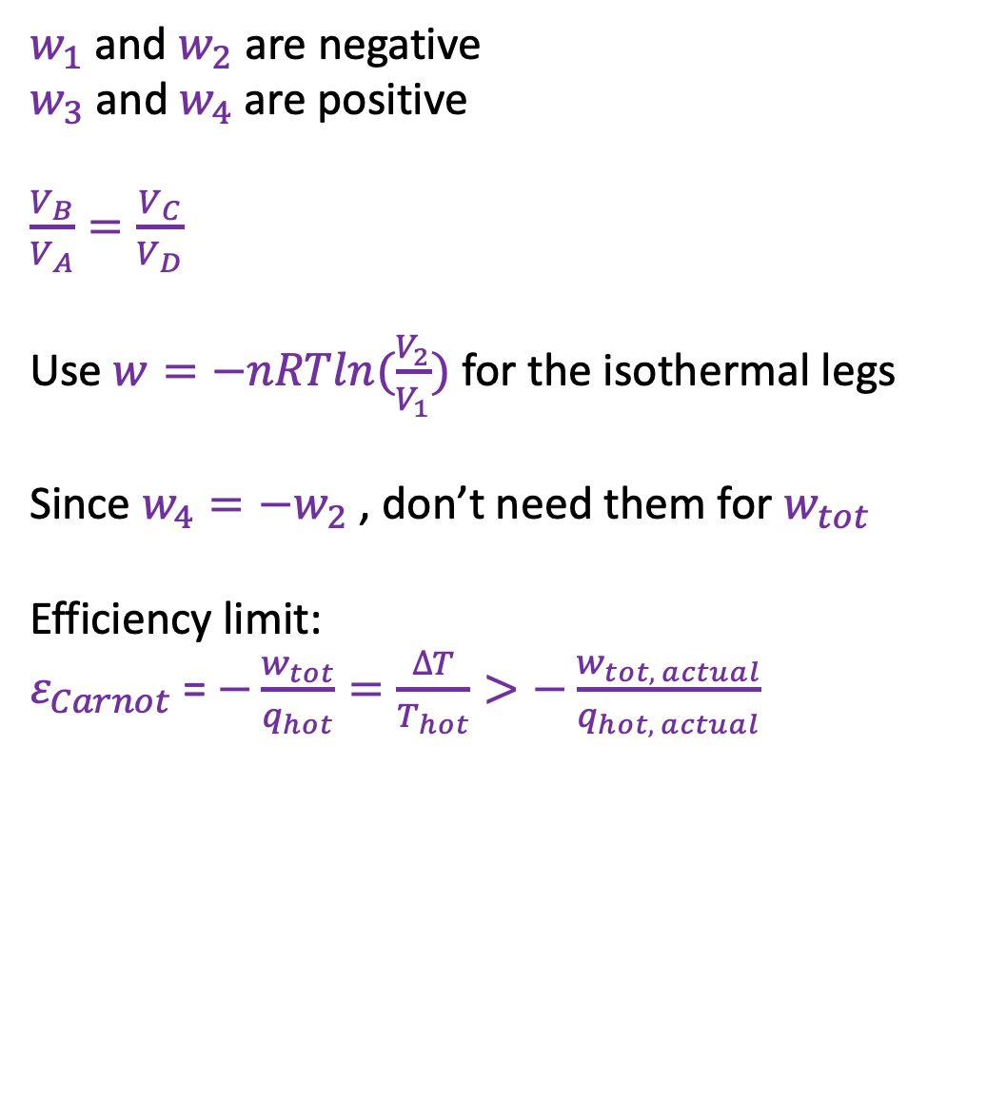
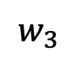
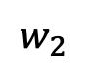
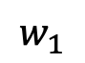
Week 6 – Carnot cycle
$w_{1}$ and $w_{2}$ are negative
$w_{3}$ and $w_{4}$ are positive
$\frac{V_{B}}{V_{A}}=\frac{V_{C}}{V_{D}}$
Use $w=−nRTln(\frac{V_{2}}{V_{1}})$ for the isothermal legs
Since $w_{4}=−w_{2}$ , don’t need them for $w_{tot}$
Efficiency limit:
$ε_{Carnot}$= $−\frac{w_{tot}}{q_{hot}}=\frac{∆T}{T_{hot}}>−\frac{w_{tot, actual}}{q_{hot, actual}}$
$$w_{1}$$
$$w_{4}$$
$$w_{2}$$
$$w_{3}$$

Slide 9

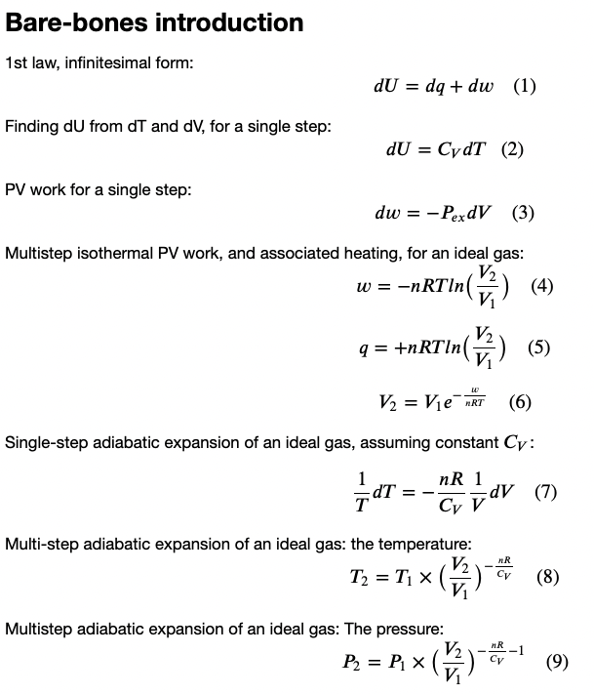
Week 6 – Key equations (and when to use them)

Slide 10
Week 6 – Key equations (and when to use them)

Slide 11
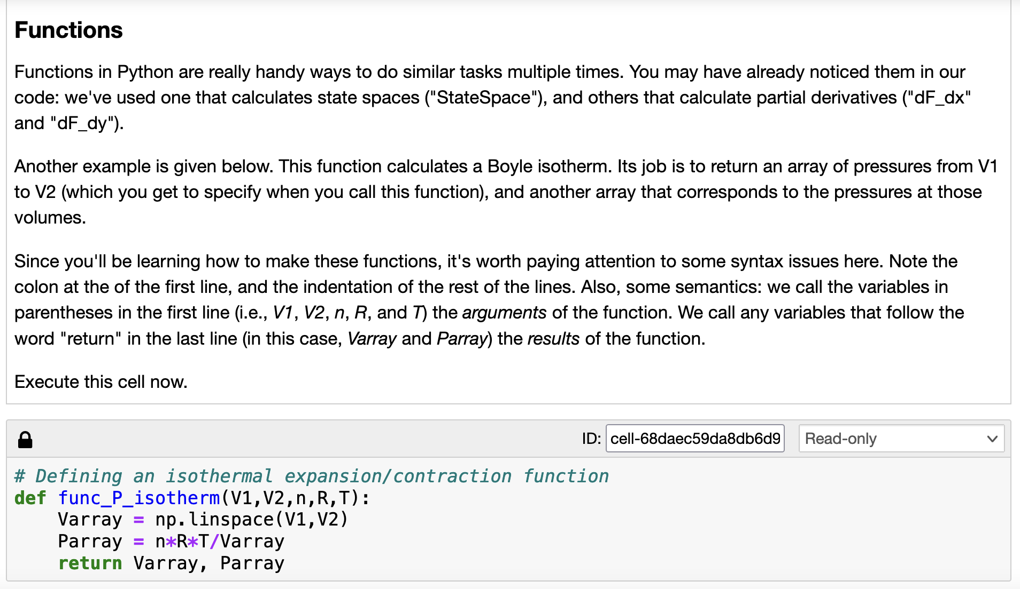
Week 6 – Python: functions

Slide 12
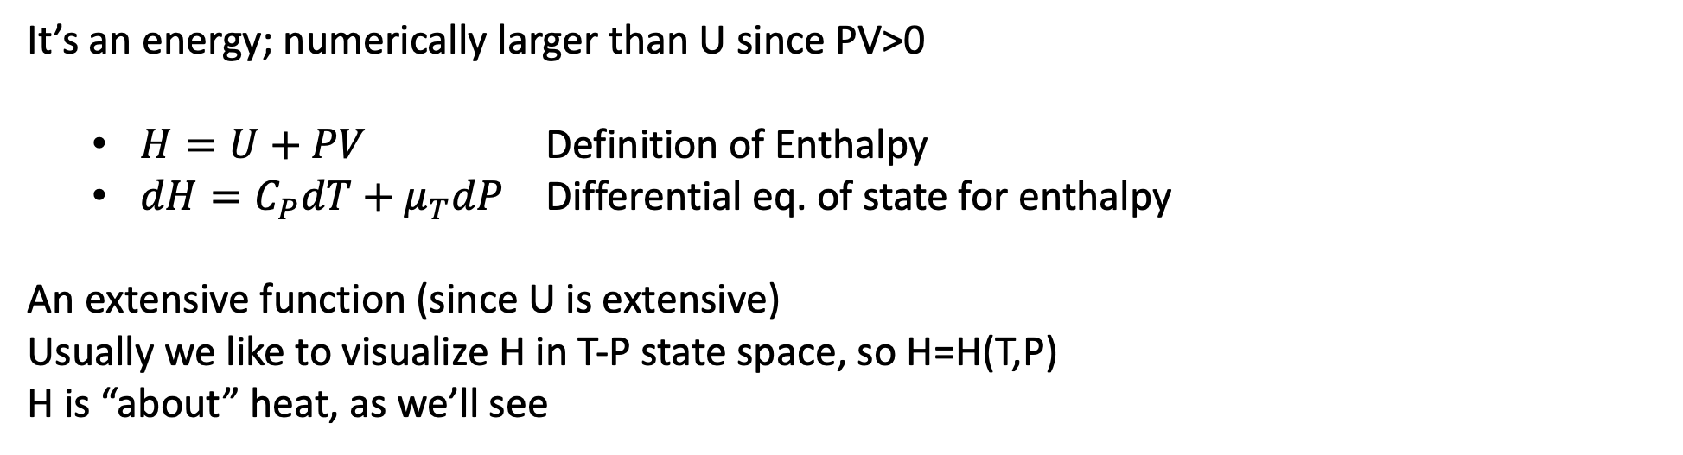
Week 7 - Enthalpy
It’s an energy; numerically larger than U since PV>0
$H=U+PV$ Definition of Enthalpy
$dH=C_{P}dT+μ_{T}dP$ Differential eq. of state for enthalpy
An extensive function (since U is extensive)
Usually we like to visualize H in T-P state space, so H=H(T,P)
H is “about” heat, as we’ll see

Slide 13
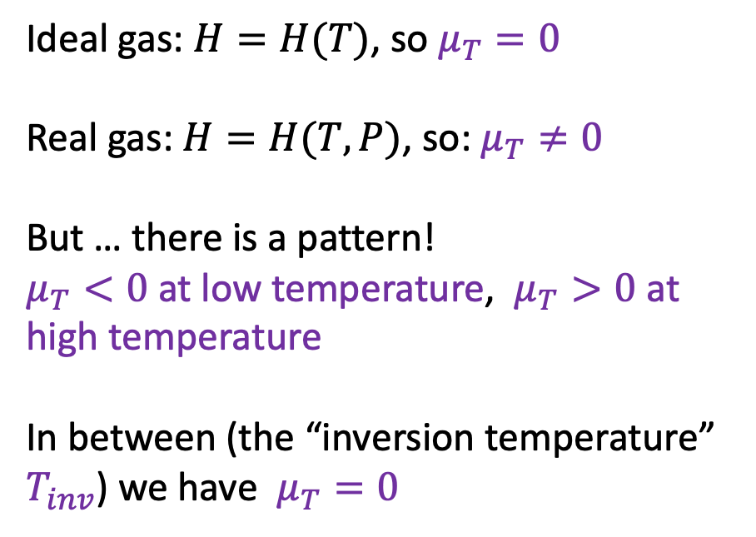
Week 7 - The twist
Ideal gas: $H=H(T)$, so $μ_{T}=0$
Real gas: $H=H(T,P)$, so: $μ_{T}≠0$
But … there is a pattern!
$μ_{T}<0$ at low temperature, $μ_{T}>0$ at high temperature
In between (the “inversion temperature” $T_{inv}$) we have $μ_{T}=0$

Slide 14
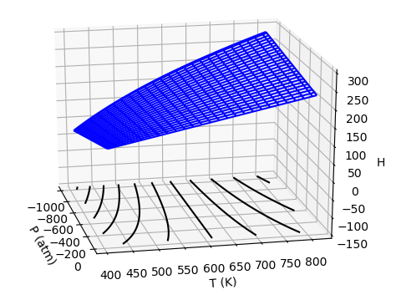
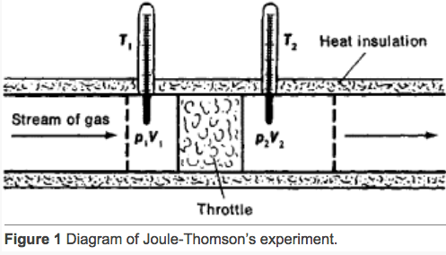

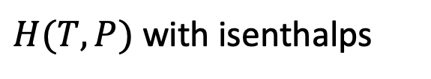
Week 7 - Measuring $μ$ by the adiabatic J-T experiment
$${μ =\left(\frac{∂T}{∂P}\right)}_{H}$$
Joule-Thompson experiment
$H(T,P)$ with isenthalps

Slide 15



Week 7 - How to get $μ_{T}$ from $μ$?
Differential Equation of state for enthalpy is
$dH=C_{P}dT+$ $μ_{T}dP$
Look at
${\left(\frac{∂H}{∂P}\right)}_{H}=C_{P}{\left(\frac{∂T}{∂P}\right)}_{H}+μ_{T}{\left(\frac{∂P}{∂P}\right)}_{H}$
P
T
0
$$μ$$
1
$$μ_{T}=−C_{P}μ$$

Slide 16


Week 7 - Critical behavior of real gases …
Isothermal compression below and above the critical temperature
$$T<T_{c}$$
$$T>T_{c}$$
gas
gas
Super-critical Gas/
Liquid
gas
liquid
liquid
liquid

Slide 17





Week 7 - Critical behavior of real gases …
Isothermal compression in an indicator diagram
$$T>T_{c}$$
$$T=T_{c}$$
$$T<T_{c}$$
Just look at the horizontal lines below $T_{c}$

Slide 18


Week 7 - Principle of corresponding states
$T_{inv}≈\frac{2a}{Rb}$ (typically >>${ T}_{Crit}$)
$T_{Boyle}≈\frac{a}{Rb}$ (> ${ T}_{Crit}$)
$T_{crit}≈\frac{a}{3Rb}$
$T_{3}≈\frac{a}{6Rb}$ (< $T_{Crit}$)
https://www.engineeringenotes.com/thermal-engineering/real-gases/real-gases-properties-van-der-waals-equation-and-equation-of-state-thermal-engineering/49112

Slide 19

Week 7 - Python: sympy (symbolic manipulation in Python)

Slide 20


Week 7 - Python: sympy (integrating and taking derivatives)

Slide 21


Week 7 - Python: sympy (symbolic bilinear Taylor expansion)

Slide 22


Week 8 - $ΔH_{rxn}$
Upper surface is vapor
Lower surface is liquid
$∆H_{rxn}$ (here, $∆H_{vap}$) is going to be smaller at the higher temperature.
That is due mainly to the big difference in slopes in the T-direction, i.e., the difference in the heat capacity:
$$C_{P}^{liquid}>C_{P}^{vapor}$$

Slide 23



Week 8 - $ΔH_{rxn}$
How $∆H_{vap}$ goes to zero at the critical temperature
Water:
At room temperature, $∆H_{vap}=44 kJ/mol$
At the boiling temperature (373 K), $∆H_{vap}=41 kJ/mol$
At the critical temperature, $∆H_{vap}=0$
All because the heat capacities of liquids are bigger than the heat capacities of the corresponding gaseous forms.
Generic $P(T,V)$

Slide 24






Week 8 - $ΔH_{rxn}$
$$C_{P}=33.6\frac{J}{mol K}$$
$$44.0\frac{kJ}{mol}$$
$$C_{P}=75.4\frac{J}{mol K}$$
H
$$50.0\frac{kJ}{mol}$$
$$6.0\frac{kJ}{mol}$$
$$C_{P}=38\frac{J}{mol K}$$
T

Slide 25

Week 8 - Python: Calculated how $ΔH_{rxn}$changes as a function of temperature and pressure
$∆H_{rxn}\left(T^{′},P^{′}\right)=∆H_{rxn}^{o}+$ $∆(∆H_{rxn})$ where
$∆\left(∆H_{rxn}\right)=\int_{P^{o}}^{P′}{{∆μ}_{T}dP +\int_{T^{o}}^{T′}{{∆C}_{P}dT}}$
where
${∆μ}_{T}=μ_{T}^{products}−μ_{T}^{reactants}$
$${∆C}_{P}=C_{P}^{products}−C_{P}^{reactants}$$

Slide 26


Week 8 - Python: Created functions for finding the heat capacity
Since the differential equation of state for enthalpy is $dH=C_{P}dT+$ $μ_{T}dP$, we created functions that made $C_{P}(T)$
Liquid
$C_{P}^{liq}$ = A + B*t + C*t² + D*t³ + E/t² (J/mol/K)
where t is in milliKelvins, T(K)/1000
Shomate parameters for liquid water:

Slide 27

Week 8 - Python: Then used what we knew about heat capacities to get $∆H_{vap}$

Slide 28

Week 9 – Phase equilibria
https://climate.nasa.gov/news/3012/nasa-led-study-reveals-the-causes-of-sea-level-rise-since-1900/
What does thermodynamics have to say about this?

Slide 29



Week 9 – The “Isobaric thermal expansivity”
$α_{P}≡\frac{1}{V}{\left(\frac{∂V}{∂T}\right)}_{P}$ … for small changes in temperature, we can say $\frac{∆V}{V}≈α_{P}∆T$
$$∆V$$
Solids and liquids: $α_{P}≈constant$
Application: Liquid water has $α_{P}=0.00021{ K}^{−1}$
So if you heat water up 10 degrees, what’s the relative volume increase?
Answer:
$$\frac{∆V}{V}≈0.21\%$$
$$V$$

Slide 30

Week 9 – The “Isothermal compressibility”
$κ_{T}≡−\frac{1}{V}{\left(\frac{∂V}{∂P}\right)}_{T}$ … for small changes in temperature, we can say $\frac{∆V}{V}≈{−κ}_{T}∆P$
Solids and liquids: $κ_{T} ≈constant$.
Application: Liquid water has $κ_{T}=5×10^{−5}{ bar}^{−1}$. So if the deepest part of the ocean has pressure of $\sim 1,000 bar$, what’s the relative volume change ($\frac{∆V}{V}$) there?
Answer: $\frac{∆V}{V}=(−5×10^{−5}{ bar}^{−1})×(1,000 bar)=−0.05$ ($5\%$).
Meaning, water at the bottom of the ocean is 5% denser due to compression.

Slide 31




Week 9 – Clapeyron equation
The Clapeyron Equation gives the slope of the phase boundary lines:
$$\frac{dP}{dT}=\frac{∆H_{trs}}{T∆V_{trs}}$$
where trs = fus, vap, or sub. For example, see the slope of the the liquid/vapor phase boundary shown at right.
$$∆H_{vap}$$
$$∆V_{vap}$$
We derived this equation later! From $dG=−SdT+VdP$, we got
$$\frac{dP}{dT}=\frac{∆S_{trs}}{∆V_{trs}}$$
Then from the thermodynamic definition of entropy, $dS=dq_{rev}/T$ and $dq_{rev}=dH$ we got to $\frac{dP}{dT}=\frac{∆H_{trs}}{T∆V_{trs}}$.

Slide 32



Week 9 – Integrating the Clapeyron Equation
It makes sense to start integration at the triple point because we know $T_{3}$ and $P_{3}$ very accurately
ice-liquid: $dP=\frac{∆H_{fus}}{T∆V_{fus}}dT$
P
liquid/vapor: $dP=\frac{∆H_{vap}}{T∆V_{vap}}dT$
T
ice/vapor: $dP=\frac{∆H_{sub}}{T∆V_{sub}}dT$

Slide 33




Week 9 – Integrating the Clapeyron Equation
Clapeyron: $dP=\frac{∆H_{trs}}{T∆V_{trs}}dT$
P
Integrating along the ice-liquid phase boundary:
$\int_{P_{3}}^{P}{dP}=\int_{T_{3}}^{T}{\frac{∆H_{fus}}{T∆V_{fus}}dT}$ → Thomson Equation
Integrating along the liquid/vapor phase boundary:
$\int_{P_{3}}^{P}{\frac{dP}{P}}=\int_{T_{3}}^{T}{\frac{∆H_{vap}}{nRT^{2}}dT}$ → Clausius-Clapeyron equation for liquid-vapor equilibria
T
Integrating along the ice/vapor phase boundary:
$\int_{P_{3}}^{P}{\frac{dP}{P}}=\int_{T_{3}}^{T}{\frac{∆H_{sub}}{nRT^{2}}dT}$ → Clausius-Clapeyron equation for solid-vapor equilibria

Slide 34

Week 9 – Python: We constructed phase diagrams from all this

Slide 35



Week 9 – Multiple ways of thinking about the liquid-vapor phase boundary
The pressure that forms the liquid/vapor phase boundary ($P_{A}^{∗}$) …
Is the pressure ($P_{A}^{∗}$) of the gaseous form of a substance in equilibrium with its liquid form.
Is also the pressure that we indicate in the two-phase region of a generic indicator diagram.
Is strongly temperature dependent: warm air “holds more water vapor” than cold air (even though you don’t need air to come to this conclusion).
Is sometimes referred to as the “Clausius-Clapeyron” curve, even though Clausius-Clapeyron is really a theoretical result.
A(g)
$P_{A}^{∗}$
A
A
A
A
A
A
Pure A(l)
A
A
Generic indicator diagram
P
$$P_{A}^{∗}(T)$$
T

Slide 36




Week 9 – Raoult’s Law and the Clausius-Clapeyron curve
${P_{A}=P}_{A}^{∗}χ_{A}$
P
A(g)
${P_{A}<P}_{A}^{∗}$
A
New equilibrium
A
$$P_{A}^{∗}$$
B
A
A
A
A
B
$$P_{A}$$
A(l) with dissolved B
A
A
T
Here, $χ_{A}$ is the mole fraction of A in the solution,
$χ_{A}≡\frac{n_{A}}{n_{A}+n_{B}}$. A handy formula: $χ_{A}=\frac{1}{1+M_{A}b_{B}}$ where $b_{B}≡\frac{mol B}{kg A}$ is the solute’s molality.

Slide 37

Week 9 – Blagden’s Law and Raoult’s Law
The freezing point of the A+B solution will be depressed compared to the freezing temperature of pure solvent A:
$$∆T_{F}≈K_{A}× b × i_{B}$$
where $K_{A}$is called the solvent’s cryoscopic constant, and $i_{B}$ is called the van’t Hoff factor ($i_{B}=1$ usually, but $i_{B}=2$ if solute is NaCl), and $b$ is the molality ($\frac{mol B}{kg water}$) of the solute. For example, if water is the solvent, then
$$K_{H_{2}O}=1.86\frac{K}{mol/kg}$$
P
$$P_{A}^{∗}$$
$$P_{A}$$
$$∆T_{F}$$
T

